Slide 1
By: USTADH TIRIMIDHI MOHAMMAD JAMIU
ZAKAT AND SADAQAT FOUNDATION
Suit 10, Tafawa Balewa Square, Lagos. www.zakatandsadaqat.org.ng
E-mail: info@zakatandsadaqat.org.ng
Telephone 234- 081 1819 3599
0803 538 2911, 0805 580 4899
ZAKAT CALCULATION WORKSHOP

Slide 2
PREAMBLE
All praise is due to Al-mighty Allah, the tireless giver, the provider for all and sundry. His bounty is infinite. His treasure is inexhaustible. The only one, unto whom none is comparable. We beseech His blessings upon the noblest creature; the most generous among the offspring of Adam, Muhammad (S.AW) whose charitable act is greater than the wind that distributes rain across the globe. May our lord’s peace, mercy and blessings be upon him, his household, companions, and those who rightly follow him till the Day of Reckoning.

Slide 3
ZAKAT DEFINITION
Zakat, Literally, means to purify, to develop, and cause to grow; but technically, it is an act of worship according to which every well to do Muslim who posses equal to or exceeding a laid down minimum(Nisab), has to give away, at the prescribed rate, a portion of it to the deserving poor and the needy. It is usually an annual event and un-debatable third pillar of Islam.

Slide 4
COMPREHENSIVE UNDERSTANDING OF ZAKAT
INTRODUCTION
Zakat is the most forgotten pillar of Islam in the modern time. Since 1924 Zakat as an Islamic Institution has been facing a lot of challenges and retrogression. It is almost gone into extinct(ion).
A good number of Muslim Countries, Organizations, Foundations and Cooperate individuals are vigorously working, toiling to ensure that Zakat is back to its rightful position in Islam. In recent time they came together in Sudan to form GLOBAL UNION FOR ZAKAT RITE (GURZ).
In a bid to ensure that Zakat as an Islamic Institution succeed and excel, Zakat Workers need to perfect the following:

Slide 5
COMPREHENSIVE UNDERSTANDING CONTD.
Comprehensive Understanding of the Dutiable Items of Zakat.
Understanding both Open and Hidden Zakat Items.
There are some Zakat items which are open and not confidential, these are:
Farm Produce, grains, fruits and the likes
Live stocks such as camel, cow, sheep and goat.
These can be easily enforced by Islamic Government or its representatives. One could recall Caliph Abu Bakr when he remarked:
“If they deny me the rope with which they used to bring their Zakat to Holy Prophet (SAW), I shall fight them for it”.
The Confidential Items of Zakat are Cash, Bank notes, Merchandise items and the likes.
Potential Zakat payers in this aspect need a lot of orientation, spiritual training and interest arousal to avoid evasion.

Slide 6
COMPREHENSIVE UNDERSTANDING CONCLSN.
2. Good Administration.
- This involves majorly two areas:
Good selection of Zakat workers
Prudent disbursement of Zakat fund.
Q 28 Vs 26 (“……the best you can employ is the powerful, competent and trustworthy”)
3. Perfect Distribution of Zakat Fund
(Q 9 Vs 60)
4. Complement all Endeavours with Islam in creating an enabling environment for the institutionalization of Zakat.

Slide 7
TYPES OF ZAKAT
1 Obligatory
Zakat of Gold and Silver(Money)
Zakat of Trade
Livestock
Farm Produce
Non Obligatory
Charitable acts
NB: Zakatul fitr

Slide 8
MODERN CATEGORISATION OF ZAKAT
The Mineral Resources.
Muslim Commercial Banks and Finance Houses.
Muslim Owned Manufacturing Companies.
Salaries (especially senior civil servants and blue chip companies).
Muslim Institutions.
Politicians (especially in Nigeria).
Prosperous Traders, Farmers and Artisans within Muslim Community.

Slide 9
Conditions Governing Payment of Zakat
Must be Muslim
He must not be a slave
Must be matured and sane
The wealth must be Zakatable
Income must be Halal
Must be free of debt
Must be an excess after satisfying the
personal need of the payer
Possession of Nisab(Required Minimum Amount = 20 Dinar = 85g of gold= (N1,183,030) for 1439 AH
The wealth must be invest-able
Full control over the wealth
Duration of a year

Slide 10
Rates of Zakat
Wealth or asset on which zakat is payable or on which zakat will be determined | Minimum Possession | Rate of Zakat
Gold, Silver or ornaments | 85 grams of gold or 595 grams of silver | 2.5% of the Value
Cash in hand, Stocks, bonds, trading goods or any other liquid asset | Amount equivalent to 595 grams of silver | 2.5% of the amount
Agricultural Produce | 5 Wasaqs. (1,200mudds of grains) 653kg per harvest | 5% of the produce of irrigated land, 10% in the farm of non-irrigated land 7.5% partially irrigated land
Product of mines | any amount | 20% of the value
Camels | 5 camels | 1 sheep or goat
Cow | 30 cows/40 cows | 1 yr 0ld cow/A 2 yr old cow
Goats | 40 goats | 1 goat

Slide 11
UNDERSTANDING NISAB CALCULATION
1. NISAB ON GOLD
- 20 Dinar or 85g of Gold
- 200 Dirham or 595g of Silver
2. NISAB ON LIVE STOCK
5 camels
30 cows
40 sheep
3. NISAB ON GRAINS (CROPS)
5 Wasaqs of grains (A wasaq is 60 sau, a sau is 4 muds. Grains nisab is 5 x 60 x 4= 1,200 mudds or its equivalent in grains if weighed on a scale (653kg) i.e about 13bags of 50kg

Slide 12
NISAB CALCULATION FOR GOLD
This is most technical area, because of the effort and technicality involved in knowing the value of gold/silver and its conversion to local currency.
For example this year (1439AH)
9 Karats =
10 Karats =
18 karats = N11, 483 X 85 = N976,055
21 Karats =
22 Karats = N13, 918 x 85 = N1,183,030
24 Karats = N15,309 x 85 = N1,301,265

Slide 13
NISAB CALCULATION FOR SILVER
595g of Silver = 308.37usd x N362 = N111,629.94
(N111,630) approximately.
N111,630 ÷ 40 = 2,790.75k
(NGN Exchange rate is N362)
N200,000 ÷ 40 = N5,000
N300,000÷ 40 = N7,500
N400,000÷ 40 = N10,000
N500,000 ÷40 = N12,500
N1,000,000 ÷ 40 = N25,000
And so on

Slide 14
CALCULATION CONTD (GOLD)
Our Nisab this year is = N1,183,030
Minimum Zakat = N1,183,030 = N29,575.75
40
Minimum amount of dowry (1/4 of Dinar)
N1,183,030 = N59,151.5 = 1 Dinar
20
Therefore ¼ Dinar = N59,151.5 = N14,788
4
Diyat is equal to current Nisab in fifty places
N1,183,030 x 50 = N 59,151,500
NB: Our Nisab for Zakat this year is N1,183,030
Zakat for Silver this year is N112,000

Slide 15
CONCLUSION
Gold value is the globally most accepted standard for calculating Nisab. However there are those who quest for the use silver as standard which we have provided above.
Silver had only been an option since prophetic era. Initially it was a Persian currency and it is currently unstable in the international market.
With silver as Nisab, Zakat payers will increase tremendously. The irony is that a good number of them will also apply for Zakat as recipients.

Slide 16
Calculating Zakat on Gold
The Gold used for occasional purposes or for rent or any commercial use would be Zakatable as long as it is up to 85gm of gold. Though some scholars said even those for regular use are Zakatable as long as they are up to 85gm of gold, however emphasis should be on those kept for occasional use and for commercial purposes.

Slide 17
Calculating Zakat on Gold Contd.
A. 85gram ÷ 40 = 2.125 grams of gold
- 100gram ÷ 40 = 2.5 grams of gold
- 200gram ÷ 40 = 5 grams of gold
B. Find its local currency equivalent.
Divide it by 40 is equal to Zakat
e.g N2,000,000 worth of Gold divided by 40 = N50,000
Zakat on JEWELRIES. If it reaches Nisab, its also Zakatable. According to Imam Abu Hannifah.
See Fiqhus-sunnah Vol. 1 pg 289-290

Slide 18
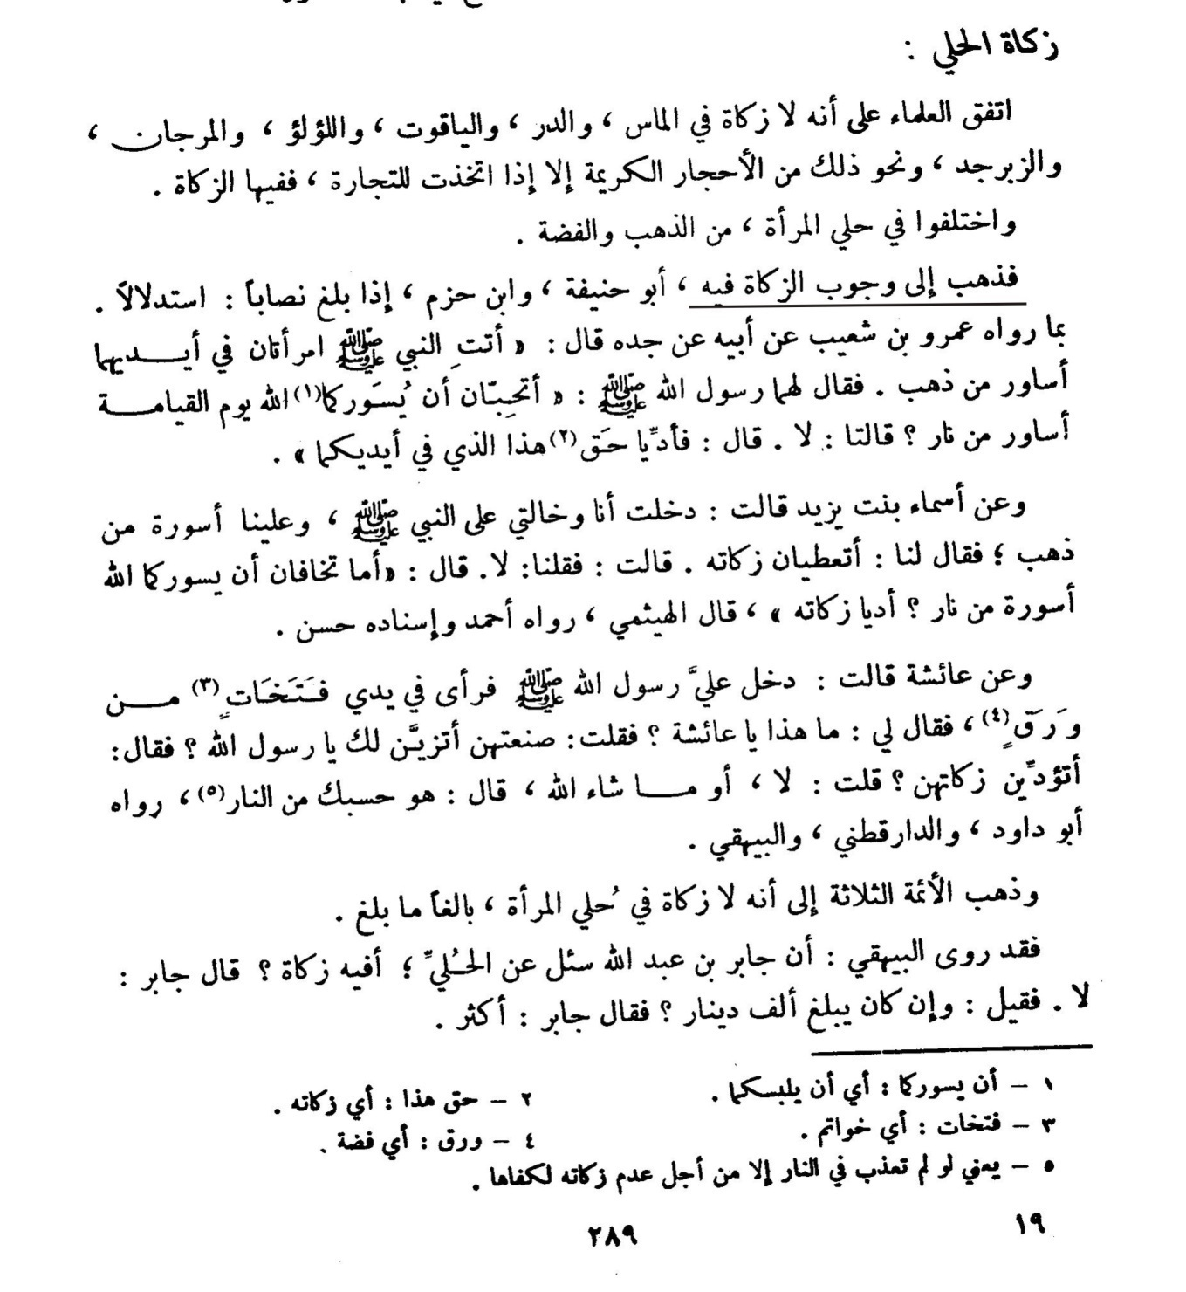

Slide 19
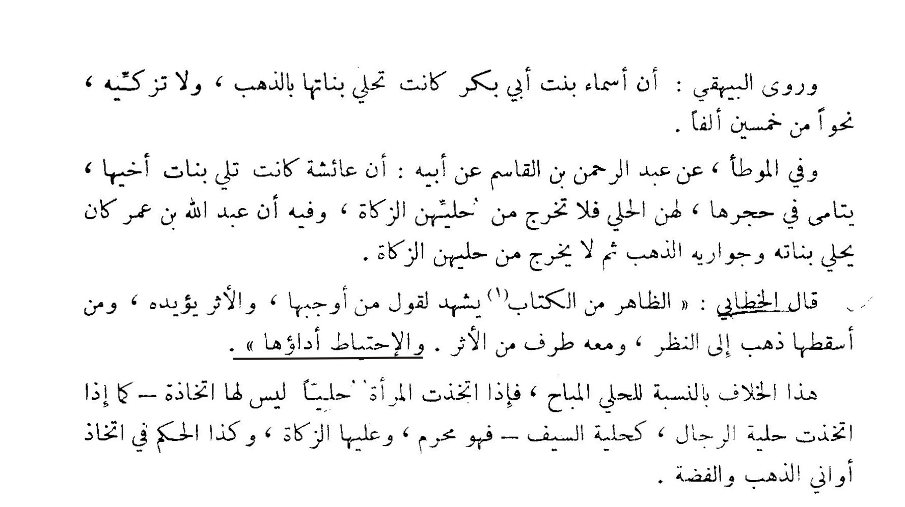

Slide 20
ZAKAT ON MINERAL PRODUCTS
The mineral resources such as Crude Oil, Diamond, Bitumen etc are Zakatable see Q 2:267
Propher (SAW) “and from buried treasure is a one-fifth” that is a fraction of 1/5 or 20%
NNPC Production projection for 2018 budget is 2.3m pbd (2,298,000 pbd x 45usd = 103,410,000 usd daily x 362 = N37,434,420,000
AV 40B bpd because last sales in Nigeria was at 52.49usd
Zakat rate at N37,434,420,000 x 20% = N7,486,884,000 pd
Average Zakat rate at N40,000,000,000 x 20% = N8bn pd as Zakat

Slide 21
Zakat on Farm Produce
Farm Produce are generally Zakatable, particularly those in the family of grains;
a. All family of maize b. Cocoa
c. Cashew nut d. Ground nut
e. Kola nut f. Palm kernel
g. All types of beans h. All types of rice
i. Guinea corn j. Millet
On these grains there are difference of opinion on weather the curbs or pod be removed before Zakat is calculated or not, however which ever is applied it will be acceptable. Nisaab is 5 wasaq.
The farmer shall remove 1/3 of his total yield and base his Zakat on 2/3 of the remainder

Slide 22
Rates of Zakat
Wealth or asset on which zakat is payable or on which zakat will be determined | Minimum Possession | Rate of Zakat
Agricultural Produce | 5 Wasaqs. (1,200mudds of grains) 653kg per harvest | 5% of the produce of irrigated land, 10% in the farm of non-irrigated land 7.5% partially irrigated land
Product of mines | any amount | 20% of the value
Camels | 5 camels | 1 sheep or goat
Cow | 30 cows/40 cows | 1 year 0ld cow/A 2 yr old cow
Goats | 40 goats | 1 goat

Slide 23
Zakat on Farm Produce Contd.
B. 1,200 muds of grains or 653gk (or about 13 of 50kg bags)
C. Non- Irrigated - 1,200 ÷ 10 = 120 muds
- Irrigated – 1200 ÷ 20 = 60
Combination of both Irrigated and Non-Irrigated produce = 1200 ÷ 15 = 80muds
D. 20 Bags of 50kg grains ÷ 10 = 2bags
20bags of 50kg grains ÷ 20 = 1bag
20 bags of 50kg grains ÷ 15 = 1½ bags.

Slide 24
Zakat on Fruits
Fruits includes
i) Tomatoes ii) Pineapple iii) Banana
iv) Pawpaw v) Spinach (Efo)
vi) Okra (Ila) vii) Oranges and the likes
Though all of the above were not Zakatable before but due to their commercial value now, they were considered to be Zakatable.
The whole products will be valued and if up to 85gm worth of gold then 2.5% will be paid as Zakat
The same ruling goes for poultry farming, snail rearing, fishery and rabbit keeping
A Muslim trader in fruits who has items worth of 1.5m = 1,500,000 ÷ 40 = N37,500
He can pay in cash and or materials.
Zakat rate is 1/40 as in trade.

Slide 25
Zakat on Palm Oil, Honey and Milk
Some scholars agreed that Nissab of honey, groundnut oil and palm oil are the same and this is the popular opinion. Nissab is 160Ltrs or 653kg
Zakat is 1/10 if on plain ground but 1/20 if on a hill top or mountain.
On milk the source of production of the milk will not be Zakatable, but the milk will be Zakatable. Supposing the cattle were being reared for sale and at the same time used for milk production then the Nissab will be 85gm of gold of worth of the cattle and the Zakat is 2.5%. But if the animals are being used for milk production alone then the judgment of honey holds, that is 160Ltrs or 653kg of the milk
ZAKAT ON HONEY- As at the time of writing this paper, 5litres of honey is N10,000. The calculation is 160 ÷ 5 = 32 x 10 = N320,000 Zakat = N32,000
- Non- irrigated is 320,000 ÷ 10 = 32,000
- Irrigated would be 32,000 ÷ 2 = N16,000 0r 320,000 ÷ 20 = N16.000

Slide 26
CALCULATION OF ZAKAT ON PALM OIL
B. As at the time of compiling this work, 20litres of palm oil is N10,500. The calculation is 160÷ 20 = 8 x N10,500 = N84,000.
Non- Irrigated Zakat is N84,000 ÷ 10 = N8,400
Irrigated – N8,400 ÷ N4,200 or N84,000 ÷ 20 = N4,200
C. ZAKAT on milk as in B and Zakat on fruits
B for non irrigated
- as in Zakat on fruit / trade because in most cases in the modern time, mass production of milk is through industries

Slide 27
Zakat on Land and Landed property
The intention of acquiring a landed property or land is very important and must be verified for Zakat purpose
If the intention for purchase is for private use then Zakat will not be paid on it, but if it is for business or commercial purpose then Zakat will be paid.
However if the intention is not clear or not yet decided by the owner as to what use the land will be put then no Zakat will be paid. Same judgment will hold for equipment.
The Nissab is 85gm of gold at 2.5%.
Valuation report is here a key. Zakat is only considered from the value that is up to and beyond Nisab.
If it is a vast land, Zakat can be collected directly from the material (Land) at 1/40
i.e. 1 plot of land as Zakat from 40 plots and so on.

Slide 28
Zakat on Company, Transportation business (vehicles, ships and aero-planes) and Artisans
Net profit of the company is recommended;
if Net profit is up to Nissab, 10% or 5% of the profit will be taken as Zakat.
There is another opinion that says that the gross assets less total liabilities can also be used;
if the balance is up to Nissab then 2.5% will be paid as Zakat. (Fiqh Islamy wa adilatuhu by Dr Wahaba Zuhayli & Fiqh Zakat 2nd Edition pg 479)
Industrialists mostly operate through statement of account; we calculate Zakat on the surplus. If up to Nisab. It can be separately or collectively. E.g An individual with 2 or more companies.
Artisans: Zakat here is from cash at hand and cash in bank if up to Nisab

Slide 29
ZAKAT OF PRIVATE SCHOOLS
Schools are categorised into two;
1) Schools for social services (Not Zakatable)
2) Schools for business services (Zakatable)
There are schools established for waqf (endowment) which can be classified into three types;
1) Waqf khayr: Here all proceed from the school will be used for the work of Allah and other social services and not for any personal benefit, the management of the school must be handed over to a Foundation or an organization.
2) Waqf A’ali: The school will be handed over to a particular family for management and for benefit of the family. This may be for a particular period of time or for ever.
3) Waqf khayr & A’ali: This is the combination of the two above.
The first type is not Zakatable but the other two are Zakatable. In waqf A’ali all the profit will be subjected to Zakat while for waqf khayr & A’ali the profit element that relates to waqf A’ali alone will be subjected to Zakat and Nissab is 85gm of gold at 2.5%.
Zakat calcucation here is terminal or yearly. N1.5m Terminal. 500,000 x 3 would be yearly

Slide 30
ZAKAT OF SALARY EARNERS
Any salary earner that will be Zakatable must have excess of income over his expenditures after satisfying his immediate personal needs also to be considered is cash or its equivalent (Shares or investments and other related incomes) the left over must be up to Nisaab.
If a person gets a very big salary such that what is left unspent every month is always up to Nisaab, such a person can choose to pay his Zakat monthly or accumulate it till the end of the year before payment.
Also if a person is getting an average salary (say N500, 000) and wants to sacrifice some of his needs so as to make him have up to Nisaab and make him qualified to pay Zakat, the person can be encouraged to do so.

Slide 31
PROFESSIONAL FEE
If the fee collected is up to Nisaab Zakat will be paid on 85gm of gold at 2.5%
N1.5m gain in a professional deal and above is Zakatable.
i. – N1,500,000 ÷ 40 = N37,500n OR
Ii- N500,000 x 3 = N1.5M and Zakat is as in (i).
The implication is that, if a professional makes gains 5 times or more in a year, his Zakat is 5 times or more. See Q 6:141.

Slide 32
Zakat on Contract and Gift
On contract Zakat should be paid as soon as the money comes in after netting off the expenses if up to Nisaab then Zakat will be paid on 85gm of gold at 2.5%
Any gift(s), pension, gratuity, ester code and inheritance that is up to Nisaab of 85gm of gold and no debt on the beneficiary then Zakat is to be paid immediately at 2.5% or 1/40
Same goes for arrears of salary, bonuses, and allowances and so on.
These are all referred to as “MAALUL-MUSTAFAAD”

Slide 33
Zakat on Rental Business
If the income from the rent or any rental business is up to Nissab then Zakat will be paid on it at 2.5%
A Muslim having 4 flats in a building at N500,000 each and earning N2,000,000 annually is Zakatable
N2,000,000 ÷ 40 = N50,000 as Zakat
If he occupies 1 flat for private use the rest 3 flats at N500,000 each x 3 = N1.5m ÷ 40 = N37,500 would be his Zakat

Slide 34
Zakat on Stocks(Shares)
It was agreed that the dividend on the shares and the shares value should be added together and if up to Nisaab of 85gm of gold Zakat will be paid at 2.5%. But if not, it may be added to other income for Zakat. If the share is the only means of livelihood then his expenses must be deducted before Zakat will be due on such a person.

Slide 35
NOTES
It is permissible to pay arrears of Zakat in case of dead Muslim before the distribution of his estates to his legal heirs. See Q4:11-12 (… Distribution in all cases is after the payment of debt (Zakat, hajj, kaffaarah and diyah…) and execution of his will…)
Zakat arrears is also collectible from evaders. And at times, he pays fine as directed by Islamic authority in his locality
Zakat can also be collected in advance (Twice or thrice in a year) in case of pandemic poverty and fatawa of Ulama in that regard.

Slide 36
LIMITATIONS ON ZAKAT ITEMS
According to Imam Ibn Hazm in his book Al-Mahalla;
Zakat items are limited to eight items;
Camel, Cow, Sheep/Goat, Wheat, Grains, dates, Gold and Silver.
- Also Imam Shaokani, Sadeeq Hassan Khan sahare same. This opinion is however myopic, however Imam Abu Hanifah expanded this scope via these principles.

Slide 37
CONTINUATION
Zakat is collectible from all legitimate growing earning irrespective of time and place, he proved this by saying (Q 70:24-25)
And that Umar included Zakat collection on horse.
Imam Ahmad Ibn Ambali collected Zakat on honey and minerals.
Imam Zuhri, Hasan Al-Basri and Abu Yusuf, obliged Zakat on sea minerals such as jewelries e.t.c.
Imam Shafi’i added to Zakatul Fitr “Most common food in an area”.
NB: In this age of expansive urbanization and modern technology can we focus only in our zakat collections on the local farmers and herdsmen / cattle rearers? leaving behind professionals such as doctors, engineers, lawyers, accountants, architects, consultants and industrialists in various fields?!. You can imagine the great loss In Zakat collection and distribution. If they are nowadays included accordingly, you can also see and feel the great success

Slide 38
Collection
Khudh min Amwalihim Sodaqah…(Q9v103)
Prophet appointed Collectors (Muhaz bin Jabal, Abu Hurayra,…)
The Qualities of a Zakat workers (Collectors):-
1. Knowledgeable
2. Trustworthiness / piety. (See Q 28:26)
3. Humility
4. kindness / subtleness
5. Truthfulness
6. Good human relation
7. Self confidence
8. Dynamism
9. Innovation
10. Contentment ( a case of the man Al-baahili)
Set up Baitul mal (Treasury)
Keeping proper records(Accountability)
(… father hire him the best employee for you is the strong and trustworthy…)

Slide 39
Distribution
Innama sodaqaatu lilifuqaraa…(Q9v60)
The poor
Needy
Zakat workers
Converts in the making
Debtors
Those in slavery
Wayfarers
Fiseebililah

Slide 40
Zakat Challenges
Payers Attitudes
Confidentiality
Evaders of Zakat
No record keeping
Misunderstanding
Procrastination etc
Beneficiary Attitudes
  Confidentiality
  Not ready to be identified as recipients
  Not having a grantor
  Not ready to comply with procedures
  No identity card
  Argument between progressive and conservative Muslims in the modern time.

Slide 41
ADVICE
Let us revive the Islamic era of Abubakri, Umar (I) and Umar (II).
Do not exhibit the behaviour of Qaroon and the Owners of the garden. (Q28 VS 76-83) and (Q68 VS 17-33)

Slide 42
BENEFITS OF ZAKAT
It cleanses off your sins
It’s a means of economic empowerment
It’s a means of keeping the family ties together
Increase in Wealth
Broadcasting of ALLAH’s love
Relief for the poor and Needy
Provision of Infrastructures
Protection against disasters
It sanitizes the society from immoralities and vices
Facilitate smooth spread of Islam
Divine assistance from ALLAH
Safety from hellfire
Assurance of entering paradise

Slide 43
Conclusion
Prophetic prayers for Zakat Payers:
Baaraka Llahu Feema A’atoetum
Wabaraka Llahu Feema Abqaetum.
(May Allah bless what you have given out and may He bless what remains)
Thanks for your rapt attention. May God bless you All.
Alhamdu Lillahi Rabbil Aalamin.

Slide 44
Bank Accounts
Account name: Zakat and Sadaqat Foundation
Zakat Account
Sterling Bank Plc. (Alternative Finance) Marina, Lagos.
A/c No.: 0500267463
Zakat Account
ACCESS Bank Plc. Jibowu, Lagos.
A/c No.: 0030378184
Sadaqat Account
GTBank Plc, Moloney, Lagos Island
A/c No.: 0016101110
Waqf Account
Zakat & sadat foundation
GTBank: 0131805881

Slide 45
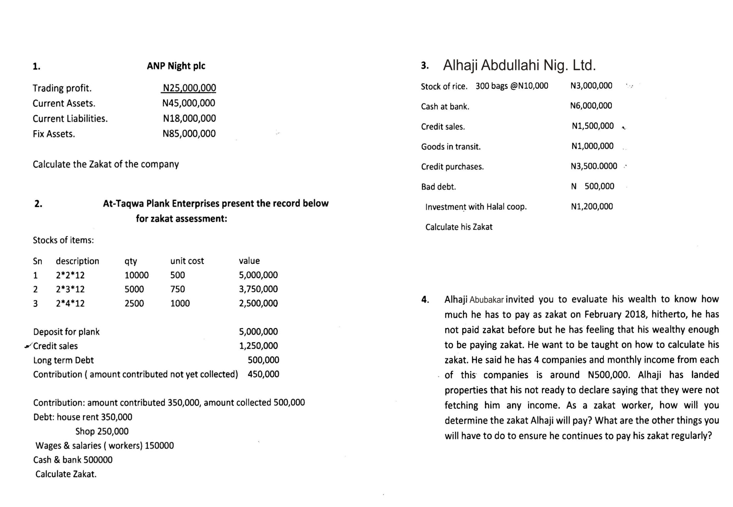

Slide 46
THANK YOU FOR LISTENING AND
GOD BLESS

